Slide 1
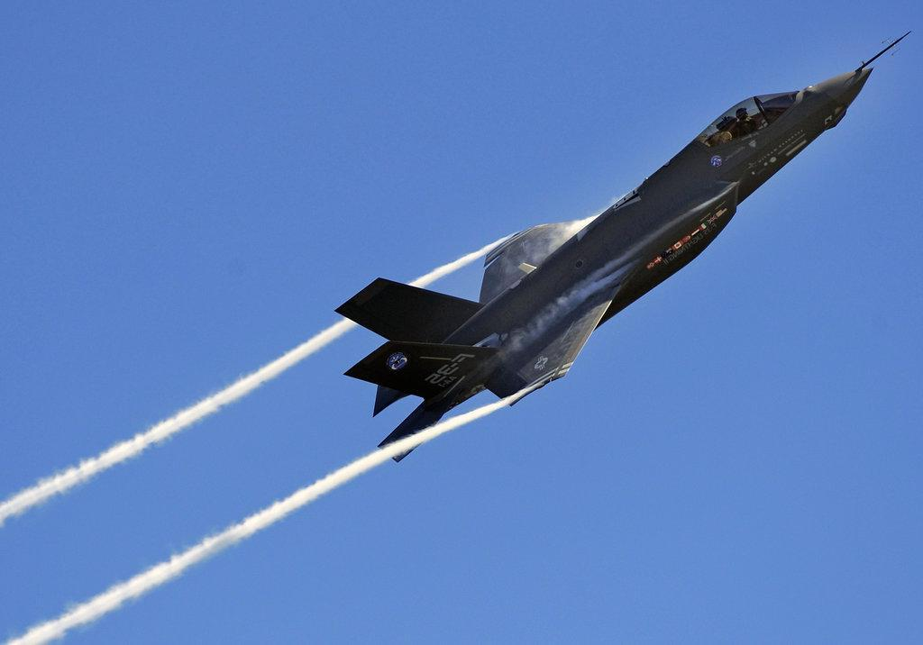
Software Foundations in JAVA (JSF)
Lesson 2 Linux & Java
Peter Boots
p.boots@fontys.nl
Erik van der Schriek
e.vanderschriek@fontys.nl

Slide 2
Overview
Shell
Package manager
Interoperability with JAVA
Assignment week2
Notes:
Next: what is an OS

Slide 3
Shell
Redirection & pipes
Filtering
Environment
Notes:
JAVA: multiplatform, netbeans.
Software: best practices during design, solutions for problems, making choices
Foundations: use of Linux and Windows, use of API’s, especially concurrency

Slide 4
Redirection
ls –l > overview writes the output of the ls –l command to the new file overview instead of to the standard-output (the screen)
cat file1 file2 >> overview adds the content of file1 and file2 to the file overview
Keyboard=/dev/stdin, screen=/dev/stdout
program < file1 > file2 will start program with input coming from file1 and the results being written to file2

Slide 5
Pipes
The output of one command can be the input of the next command, by using the pipe operator (symbol | ), e.g.:
ls –l /etc/ | less
shows the long list of the content of /etc/ directory, page by page (command more and pg have similar functions as less)
standard in
| (pipe)
standard out
ls -l
less

Slide 6
Filtering
Manipulation of inputstream to outputstream
Especially used with piping
grep: filters lines that contain ‘something’
sed: manipulates an entire stream per character
sort: sorts
uniq: removes duplicates
Also: man pages

Slide 7
Environment
(Global) variables in a shell
locations, settings, defaults
To show use: ‘set | more’ and ‘env’ (exported)
In Windows use: ‘set’
How to create? On command line:
  name=value or
  export name=value → exported
Obtain value: $name (”$name” and/or ${name} )

Slide 8
Package manager
Market for linux apps = repository
Per distribution, extendable with extra repositories.
Repositories are in /etc/apt/sources.list
apt-get update (after changes in sources.list)
apt-get install
apt-get upgrade
apt-get remove
apt-get purge
Search via apt-cache search
See: MAN pages,https://help.ubuntu.com/community/Repositories/Ubuntu

Slide 9
Interoperability shell and java
Environment variables
Properties file
Command line parameters
(Dis)advantages?
See: http://docs.oracle.com/javase/tutorial/essential/environment/config.html
Notes:
Voor/nadelen per user, programma instantiatie, over programma’s heen. System settings & user settings

Slide 10
Assignment
See Canvas

Slide 11
Homework
Mandatory study
  Linux: http://linux-training.be/files/books/LinuxFun.pdf H:10-15
  http://docs.oracle.com/javase/tutorial/essential/environment/config.html
Suggested study / background information
  https://help.ubuntu.com/community/Repositories/Ubuntu

Slide 12
End of Chapter

